Slide 1
ZSCALER PRIVATE ACCESS

Slide 2
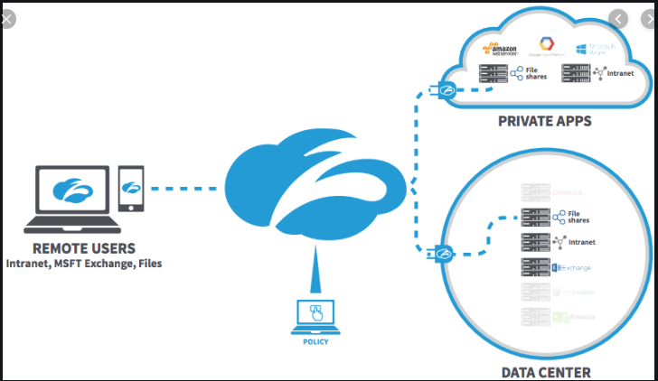

Slide 3
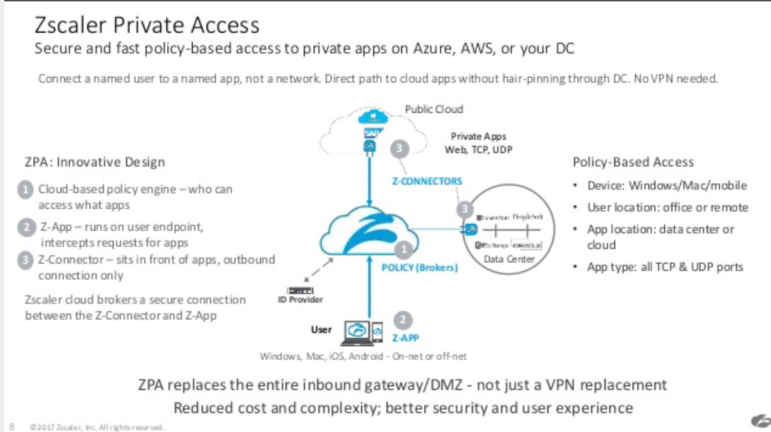

Slide 4
